Slide 1
In-Market Playbook
Notes:
Title Slide Instructions:
Title: Arial Bold, 28pt.
Subtitle/Presenter Name: Arial Regular, 22pt.

Slide 2
Agenda
Introduction and Overview
In-Market audience definitions
Audience selection process flow
2024 Accomplishments
Projects Completed in 2024
Tests Conducted with Results
Current Projects
Projects in Progress

Slide 3





Conversion | Audience Definition
The Conversion pod has two kinds of audiences – In-Market and Affinity. In-Market audiences show a higher likelihood to purchase based on their behavior.
In-Market : In-market audiences are people actively considering or in the process of buying a particular product or service. These individuals have shown intent through actions like browsing, or engaging with relevant content, signaling that they are likely to make a purchase soon.
Key Metrics/KPIs
Audience Composition
Conversion Rate & Sales Per HH/ECR (At both In-class and Enterprise level)
Incremental Revenue On Ad Spend (iROAS) & Incremental Revenue (IR)
The audience base currently consists of Pros and Consumers with a split of 40% and 60%
Audiences are created and targeted daily
Campaigns have been rolled out only at the ECR level since Q1 2025
Audience Sources
Deterministic Model: Predicts who will purchase in the next 14 days based on their browse signals for the last 14 days and R3 sales
Probabilistic Models: Predicts the likelihood of who will purchase in the next 30 days based on their browse signals for the R3 and R12 sales

Slide 4
Conversion | Audience Composition
Category Opportunity
31-35% (dd 7)
1.5X
26-30% (dd 6)
Audience | Composition | Size | Class Priority
IN MARKET | Top 5% from probabilistic model (0 demi-decile) (140 classes) | ~1.5M HHs | 1-4
 | Top 50% from deterministic (90 classes) | ~500K-1M HHs
CATEGORY AFFINITY | Top 6-20% (1,2,3 demi- decile) | ~9M HHs | None
CATEGORY OPPORTUNITY | Top 21-35% (4,5,6 demi-decile) | ~9M HHs | None
CATERGORY INTENT | Top 36-50% (7,8,9 demi-decile) | ~9M HHs | None
Category Affinity
16-20% (dd 4)
4X
11-15% (dd 3)
likelihood to convert
6-10% (dd 2)
In-Market
12X
0-5% (dd 1)

Slide 5
In-Market Audience Selection Process | Household Level Campaigns
Suppressions
Class priority of 4 classes
45 days purchase suppression
Engagement suppression
Deterministic Audience (Top 50%)
.
Browse signals, Clicks, Impressions, Interactions
Audience Base
Combined Audience based on Household ID, Class
Class Prioritization
& Audience Suppression
Probabilistic Audience (Top 5%)
Enterprise/Class rolling 12 months sales, Demographics, PLCC, TSI, Movers’ data
Final Household Base
Audience creation for Custom and Perso Classes
Pipelines:
Pipeline for Household level campaigns
Deterministic Model and Probabilistic Model Pipeline

Slide 6




In-Market Audience Selection Process | ECR Level Campaigns
ECRs with browse signals in the last 120 days
Qualified audience from Household level pipeline
Getting the ECRs within the households
Final base containing the best ECRs
R12 active ECRs
Classes for Best ECR Campaigns
IB_INMKT_029_032_TOILETS_AND_SINKS_BESTECR
IB_INMKT_029_013_REFRIGERATION_BESTECR
IB_INMKT_029_022_VANITIES_BESTECR
IB_INMKT_026_001_PIPE_AND_FITTINGS_BESTECR
IB_INMKT_023_001_RIGID_CORE_VINYL_PLANK_BESTECR
IB_INMKT_027_018_EXTERIOR_LIGHTING_BESTECR
IB_INMKT_029_007_DISHWASHERS_BESTECR
IB_INMKT_023_006_FLOOR_AND_WALL_TILE_BESTECR
IB_INMKT_026_003_BATH_FAUCETS_BESTECR
IB_INMKT_023_007_ORGANIZATION_BESTECR
Household
Best ECR
Best ECR level campaigns were rolled out in Q4 2024 for 10 classes while 10 other classes were targeted for household level campaigns
Pipeline:
Pipeline for Best ECR campaigns

Slide 7
Pro/Consumer Split for In-Market Audiences
The overarching audience mix remains close to 40% Pro and 60% Consumer, though individual classes vary significantly based on product type and targeting strategy
IB In-Market Classes - Q4 FY2024 |  | Segment
Class (HH Level) | Pro | Consumer | Unsegmented
IB_INMKT_022_004_INSULATION | 46.99% | 48.70% | 4.32%
IB_INMKT_023_016_GARAGE_GENERAL_ORGANIZE | 23.10% | 68.00% | 8.91%
IB_INMKT_025_007_POWER_TOOL_ACCESSORIES | 33.83% | 57.35% | 8.82%
IB_INMKT_025_009_PORTABLE_POWER | 28.41% | 60.93% | 10.66%
IB_INMKT_026_010_WATER_HEATERS | 33.84% | 56.71% | 9.44%
IB_INMKT_027_016_INTERIOR_LIGHTING | 26.89% | 63.66% | 9.44%
IB_INMKT_028_004_CLEANING | 33.07% | 58.34% | 8.59%
IB_INMKT_028_033_CHORE | 13.26% | 78.86% | 7.87%
IB_INMKT_029_008_LAUNDRY | 17.36% | 69.91% | 12.74%
IB_INMKT_059_026_HARD_WINDOW_COVERINGS | 23.31% | 68.27% | 8.41%
IB In-Market Classes - Q4 FY2024 |  | Segment
Class (Best ECR) | Pro | Consumer | Unsegmented
IB_INMKT_029_013_REFRIGERATION_BESTECR | 20.35% | 70.94% | 8.71%
IB_INMKT_023_006_FLOOR_AND_WALL_TILE_BESTECR | 30.20% | 61.96% | 7.83%
IB_INMKT_023_001_RIGID_CORE_VINYL_PLANK_BESTECR | 31.51% | 60.67% | 7.81%
IB_INMKT_026_003_BATH_FAUCETS_BESTECR | 30.49% | 62.35% | 7.17%
IB_INMKT_026_001_PIPE_AND_FITTINGS_BESTECR | 32.94% | 60.08% | 6.98%
IB_INMKT_029_032_TOILETS_AND_SINKS_BESTECR | 28.64% | 63.52% | 7.84%
IB_INMKT_029_022_VANITIES_BESTECR | 27.58% | 64.75% | 7.67%
IB_INMKT_029_007_DISHWASHERS_BESTECR | 18.68% | 73.06% | 8.25%
IB_INMKT_027_018_EXTERIOR_LIGHTING_BESTECR | 25.37% | 67.32% | 7.30%
IB_INMKT_023_007_ORGANIZATION_BESTECR | 25.55% | 67.01% | 7.45%

Slide 8
Audience Qualification Breakdown | Q4 Conversion Classes
The final audience sets for the classes consist of audiences from both deterministic and probabilistic models, with some audiences qualifying through both which are the overlap audiences
Class | Deterministic | Probabilistic | Overlap
AIR QUALITY | 0.00% | 100.00% | 0.00%
CAULKS | 14.87% | 68.04% | 17.09%
CHORE | 0.00% | 100.00% | 0.00%
CLEANING | 23.65% | 65.94% | 10.41%
CLOSET ORGANIZATION | 0.00% | 0.00% | 0.00%
DECORATIVE HOLIDAY | 0.00% | 100.00% | 0.00%
DISHWASHERS | 6.09% | 76.91% | 16.99%
DISPOSERS | 0.00% | 100.00% | 0.00%
EXTERIOR DOORS | 3.47% | 81.69% | 14.84%
EXTERIOR LIGHTING | 10.31% | 62.10% | 27.60%
FIRE SAFETY | 1.66% | 92.37% | 5.97%
FLOOR AND WALL TILE | 4.03% | 77.84% | 18.13%
GRILLS | 12.14% | 78.63% | 9.23%
HAND TOOLS | 28.19% | 52.76% | 19.05%
HARD WINDOW COVERINGS | 2.23% | 90.11% | 7.66%
HOME & MOBILE ELECTRONIC | 100.00% | 0.00% | 0.00%
INSULATION | 0.00% | 100.00% | 0.00%
INTERIOR DOORS | 3.44% | 79.51% | 17.06%
Class | Deterministic | Probabilistic | Overlap
INTERIOR LIGHTING | 12.07% | 67.18% | 20.75%
INTERIOR PAINT | 10.96% | 82.85% | 6.19%
LAMINATE FLOORING | 2.55% | 86.82% | 10.63%
LAUNDRY | 4.36% | 78.16% | 17.49%
LIGHT BULBS | 8.66% | 87.00% | 4.34%
PIPE AND FITTINGS | 30.66% | 40.25% | 29.09%
PORTABLE POWER | 36.31% | 43.86% | 19.84%
POWER TOOL ACCESSORIES | 40.49% | 28.42% | 31.09%
REFRIGERATION | 13.27% | 65.22% | 21.52%
S/O WINDOW COVERINGS | 2.20% | 93.78% | 4.02%
SPECIAL ORDER CABINETS | 0.37% | 97.33% | 2.30%
SPECIAL ORDER CARPET | 0.41% | 98.14% | 1.45%
TOILETS & SEATS | 4.99% | 84.32% | 10.69%
TOOLS | 0.00% | 100.00% | 0.00%
TUBS AND SHOWERS | 5.98% | 64.54% | 29.47%
VANITIES | 10.66% | 61.22% | 28.12%
VINYL PLANK | 2.77% | 47.61% | 9.33%
WATER HEATERS | 2.45% | 87.11% | 10.44%
WOOD FLOORING | 2.50% | 90.18% | 7.32%

Slide 9






In-Market Personalized Product Feed
Online Ads (OLA) offer the capability for personalization
We can customize images being shown to a HH based on their search history
Signals Considered
Gather the visits for last 14 days
Gather and assign weightage to interactions captured
Rank the products based on the interaction score and list the top 12 products
If the OMS_IDs are not listed, then they are back filled using the Top Sellers
Final Product List is shared with Revjet platform
Checkout
Add To Cart
Image Interaction
Q&A
Review & Interaction
Clicks/Browse/ Interaction
Link to Miro

Slide 10
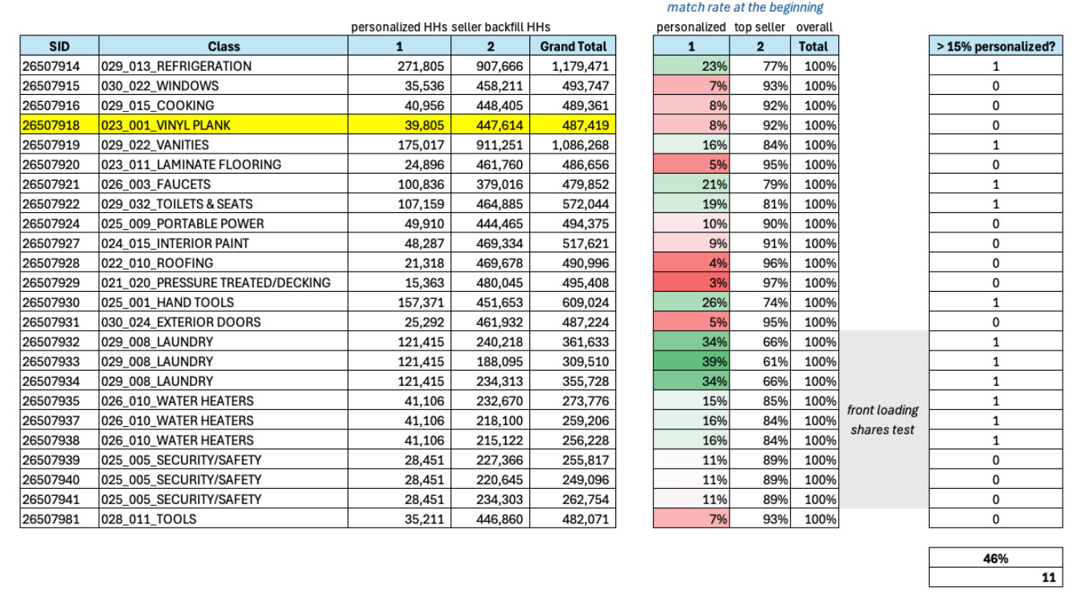
Product Feed Match Rate | Q3 2024 Classes

Slide 11







Front Loading and Percentile Suppression Test
Hypothesis
Removing the lower demi-decile, which drives sales but adds little marketing impact, may improve the KPIs and metrics.
Front-loading can optimize share allocation and align with different KPI needs by funding type.
Test Design
Share 1 - Test | Front Loaded Share with best score first (Rank/predict conversion)
Share 2 - Test | Suppress Percentile 0, 1 and then next best scores
Share 3 - BAU | No change to the inputs
How do we assess performance?
Budget Utilization
Click Through Metrics
iROAS / Incrementality
CVR, Sales per HH
Why
How
Next Steps
What
Roadmap and Impact Measurement
Test Hypothesis : Audience Viewpoint
How do we test this?
Test three audience classes with equal budget and size by comparing performance of front-loaded delivery, exclusion of lower demi-decile, and an unchanged control group.
Test/Audience Selection
Channel Selection and Strategy
Meta and OLA, same objective function as current state
Call-outs
Test share is propensity model based only. Deterministic HHs are not tested for suppression
CLASS | SVP LINE | Channel
IB_INMKT_029_008_LAUNDRY | DECOR | Meta and OLA
IB_INMKT_025_005_SECURITY_SAFETY | HARDLINES | Meta and OLA
IB_INMKT_026_010_WATER_HEATERS | BUILDING MATERIALS | Meta and OLA
What next?
Based on Learnings from the Test, work on at Full Scale.
Assessing Audience volume at Individual Level and Potential Cost Savings, with current Strategies

Slide 12
Front Loading Test Results – 1
Hypothesis 1:
The front loaded top demi deciles should have the best quality customers, which should be evident in the sales metrics compared across share types.
The hypothesis was validated across all classes
Please Note:
1.Targeted Audience were only considered for this analysis
2. Time Period: FW 27 to FW 30 (4 weeks)
3. 30 Day attribution window were considered in this analysis
4. First week of Q3 i.e., FW 27 BAU audience was not deployed for Water heaters (thus lower HH count)

Slide 13
Front Loading Test Results - 2
Hypothesis 2:
If we, suppressed top demi-deciles and front loaded lower demi deciles, we can expect higher marketing impact (given lower base propensity for lower DD).
The hypothesis was validated across all classes
Please Note:
1. Targeted Audience were only considered for this analysis
2. Time Period: FW 27 to FW 30 (4 weeks)
3. 30 Day attribution window were considered in this analysis
4. Match rate defines the total audience that were captured in the MTA table from the Refresh date
4. Marketing Impact = IR / ER i.e. (IR = Incremental Revenue and ER = Enterprise Revenue)
6. Base Propensity = 1 - Marketing Impact
7. For marketing impact, we have a lookback of 45 days
8. First week of Q3 i.e., FW 27 BAU audience was not deployed for Water heaters (thus lower HH count)

Slide 14
In-Market | Class Selection
When choosing classes, 3 different inputs should be balanced: data science analysis, merchant priorities, and measurement learnings
Step 1: Class prioritization process
Owner: Data Science
Refresh Cadence
Run each quarter. ASM requests it as they prep for upcoming quarter and needs this as reference for laying out quarterly plans for Strategic Panel regroups
What it involves (metrics?)
What it addresses/provides:
Seasonality trends – Higher weightage to quarter in consideration
Marketing Influence
Demand and performance- based on purchasers and browsers count
Step 2: Additional Considerations
Step 1: Class prioritization process
Step 2: Additional Considerations
Owner: Audience Strategy
What happens & When? occurs prior to initial Strategic Panel meeting
What it involves:
Balancing support across 3 SVPs
Factor in merchant priorities that align with the strategy
Incorporate measurement insights and revisiting performance of classes from prior year
Less emphasis on classes that show low AUR/AOV in paid media (i.e. fasteners, wiring devices, etc); partner with other teams to ensure support for these classes is happening in owned channels
Balance seasonality of the quarter
Sales: Sales per HHID AOV Seasonality trends ( Sales and visits) Marketing Influence- Visits from Non-direct Marketing channels
Visitor count Audience Count/Unique HHIDs - Sales and Visits Ensemble, Deterministic only, Probabilistic audience count Transactions Total units Product assortment and offerings

Slide 15




Class Selection | TOPSIS
Objective
Revamp the class selection criteria using the TOPSIS (Technique for Order of Preference by Similarity to Ideal Solution) algorithm, incorporating quarter-specific attributes for seasonality and prioritizing incremental revenue to better capture its impact.
Process Flow
Base Creation & Attributes
R12
Assign weights
Assign the wights to selected criteria based on requirement of campaign
Identify Solution type
Set the desired solution type to selected attributes to maximum or minimum based on criteria
Apply TOPSIS
Rank the Classes
Respective Quarter
Calculate the relative closeness and ideal solutions
Order the classes on their relative closeness values and select the top 20 classes
Metrics Considered AUR, Purchasers, Sales/HH, Units, Transactions, Visitors, AOV, IR, IR/HH, Online Sales/HH, Purchased OMS Count
Output
The classes are ranked based on the weights assigned and top 20 are selected for the campaign
Outcome
This approach has enabled business stakeholders to select the top-performing classes for each campaign, optimizing results every quarter.

Slide 16
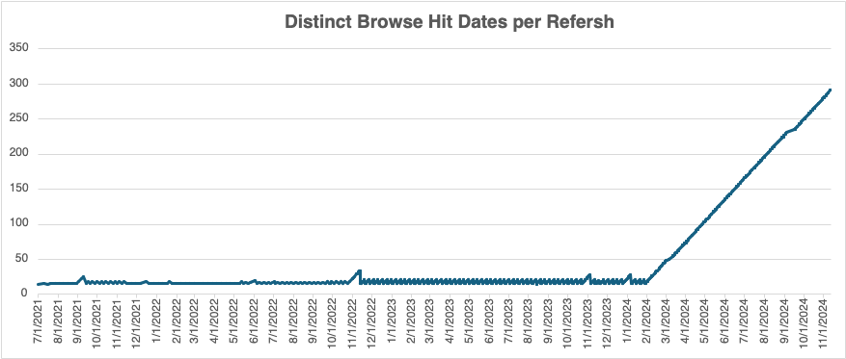
Deterministic Model Issue
Deterministic Model is supposed to lookback for last 14 days of browse behavior
However, in 2023 this lookback window would increment from 14 (on Sunday) to 20 (on Saturday) and reset back to 20.
This was slightly different than expected but not causing any major issue.
Post Feb 2024 composer change for the model refresh pipeline. The pipeline started to fail every Sunday, and the window started to increment by 1 day with every refresh. Making it reach ~ 300 as of November 2024.
The issue was fixed as of 11/26.
PRE
As Of 2023 : Lookback period increments daily but resets back to 14 every Sunday
Sunday | Monday | Tuesday | Wednesday | Thursday | Friday | Saturday | Sunday | Monday | Tuesday | Wednesday | Thursday | Friday | Saturday
14 | 15 | 16 | 17 | 18 | 19 | 20 | 14 | 15 | 16 | 17 | 18 | 19 | 20
POST
As Of 2024 : Lookback increment with each refresh
Sunday | Monday | Tuesday | Wednesday | Thursday | Friday | Saturday | Sunday | Monday | Tuesday | Wednesday | Thursday | Friday | Saturday | Sunday | Monday
14 | 15 | 16 | 17 | 18 | 19 | 20 | Didn't Run | 22 | 23 | 24 | 25 | 26 | 27 | Didn't Run | 29

Slide 17
Actual Impact | Conversion Rate Comparison (Pre and Post Fix)
On average, we are achieving a 7.4% In-Class Conversion Rate in the selected classes, with an In-Class lift of 98.5% after fixing the deterministic model
On average, we are achieving a 55% Conversion Rate at the enterprise level in the selected classed, with an enterprise lift of 23.1% after fixing the deterministic model
NOTE:
Pre-Period: Nov 19th, 2024
Post-Period: Dec 8th, 2024
This is 30 days of attribution period

Slide 18
Actual Impact | $ Per Targeted Households (Pre and Post Fix)
On average, we are achieving $13.7 per household for In-Class in the selected classed, with an In-Class lift of 69.7% after fixing the deterministic model
On average, we are achieving $397.8 per household for Enterprise in the selected classes, with an Enterprise lift of 41.6% after fixing the deterministic model
NOTE:
Pre-Period: Nov 19th, 2024
Post-Period: Dec 8th, 2024
This is 30 days of attribution period

Slide 19





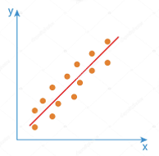

Expected Spend Model (Two Stage Approach)
Model Framework
OOTV Stage 2
OOTV Combined
Model 1
Model 2
Transactions
Class
Propensity Prediction Model
Class Spend Prediction Model
Clickstream
Demographics
All R12 Active
THD Customers
Base
Features/ Signals/ Input Data Variables
Target Variable =
Customer will purchase into class in the next 30 days
Target Variable =
Expected spend given from purchase in the next 30 days
Scored Customers
Top 5-10% picked as In-Market Audience
(rank ordered by Expected
Spend $ value)
Expected Spend Value =
Probability of Purchasing in Class X Predicted Class Spend
Example
Customer | Class Response Probability | Predicted Spend Value | Expected Spend Value | Priority Rank
A | 90% | $ 50 | 0.9 x $50 = $45 | 2
B | 70% | $ 100 | 0.7 x $100 = $70 | 1
NOTE:
1. Audience Universe: All THD R12 Active Customers
2. Model Building Time frame : Jan 2022 to Dec 2022
3. OOT Validation Timeframe: Jan 2023
4. Qualifying criteria: Customer who is likely to purchase within a class in the next 30 days.
5. Expected Spend Value: Given that a HH has a high likelihood of purchasing into a class, how much is it going to be spending (for the specific class) at THD.

Slide 20







Q2 Pro Suppression: Test Design
Test Design
TEST : Group A Vs Group B
Objective
To test if suppressing pros from our campaign and backfilling with more consumers has similar conversion and average sales value (in next 30 days) than BAU (both pros and consumers in audience)
Test Duration:
Phase 1 (6 weeks), Phase 2 (6 weeks)
Total: 13 Weeks
Channels:
Paid Media
KPIs:
Sales per HH
Conversion
Additional Analysis:
Backfill rate calculation: Estimate required backfill rate of consumers to maintain conversion & sales per HH as with both Pros & Consumers
Pro Suppression Analysis - Q1, Q2, Q3 Classes.xlsx
Campaign Creative
Group A: Consumer Only
Measure Campaign Performance
Phase 1: 600k Consumers
Phase 2: 1M Consumers Only (2X)
Campaign Creative
In-Market Audience
2 Million ECRs
Group B: BAU (Pro + Consumer)
600K Consumers & Pros
Note:
These are only rough size estimates based on 1.6X multiplier calculated as per Pre-Analysis. We will revise these numbers before Q2 launch
Pro & Consumer flags need to be at ECR level
Consumers in Group A & Group B need to be similar in composition as per – Model score / Decile distribution
ECRs to be locked into separate groups for the duration of the test

Slide 21




Q3 ATLAS A/B Test: Test Design 1
Test Design
BAU
Deterministic (50%) & Probabilistic(Top 5%) (~2.7M HH_IDs)
~1.2M ECR
Flag Creation & Prioritization
Flag Locking
Final flags(Total audience required:1.5M)
1.Class prioritization & Suppression
2.HH-Best ECR mapping
Combine the whole BAU and LSTM audiences and create flags
Flag Locking on each segment level within the class
(ECR level)
1) BAU Exclusive ~375K
2) LSTM Exclusive ~375K
3) LSTM and BAU Prob Overlap
~ 375K
4) Det Exclusive ~375K
(Challenger Det and BAU Det Overlap)
+
Measure Campaign Performance with 90/10 T/C split
Prioritize the audience using the model score to get the required audiences from the qualified base for each flags
ATLAS Audience
Deterministic (50%) & LSTM (Top 5%)
(~2.7M HH_IDs)
~1.2M ECR
Test Plan
Objective
Share Size
1.5M ECR per class
To assess whether the LSTM model is better in identifying purchasers and drives better sales compared to the XGB (SB models)
Starts on : Q3 : FW27 (August)
Duration : 8 weeks
Time Period
Note:
Each group to have similar constitution in terms of audience quality
Test to be conducted in 5 selected classes from the Q3 live classes (based on clustering)
Audience (ECR level) to be locked into separate groups for the duration of the test (6 weeks)

Slide 22
Q3 ATLAS A/B Test: Test Design 2
Test Design
Locking the audiences
BAU Audience
Deterministic & Probabilistic (27M HH_IDs)
BAU
Deterministic (50%) & Probabilistic(Top 5%) (~1.5M HH_IDs)
~750K ECR
Flag Creation & Prioritization
Final flags
1.Class prioritization & Suppression
2.HH-Best ECR mapping
Creation of flags
1) BAU Exclusive ~750K
2) LSTM Exclusive ~750K
Universe (~55M)
+
Measure Campaign Performance with 90/10 T/C split
Prioritize the audience using the model score to get the required audiences from the qualified base for each flags
ATLAS Audience
Deterministic & Probabilistic (27M HH_IDs)
ATLAS
Deterministic (50%) & LSTM (Top 5%)
(~1.5M HH_IDs)
~750K ECR
Test Plan
Objective
Share Size
1.5M ECR per class
To assess whether the LSTM model is better in identifying purchasers and drives better sales compared to the XGB (SB models)
Starts on : Q3 : FW27 (August)
Duration : 6 weeks
Time Period
Note:
Each group to have similar constitution in terms of audience quality
Test to be conducted in 5 selected classes from the Q3 live classes (based on clustering)
Audience (ECR level) to be locked into separate groups for the duration of the test (6 weeks)

Slide 23


Cross Sell Test
What are we solving ?
Increase Revenue : Additional products boosts overall transaction
Product: The ability to introduce new products will lead to better inventory at low cost.
Implementation
Expand the existing model to analyze in-market/class audiences (HH or ECR) based on primary products they are likely to purchase.
Analyze Home Depot’s transactional data to identify product pairings.
Example: “Customers who buy power drills often purchase drill bit sets”
How do we assess performance?
Budget Utilization
Click Through Metrics
iROAS / Incrementality
CVR, Sales per HH
Why
How
Next Steps
What
Targeted Customer Segments
Consumers who detect purchasing behaviors, needs, or preferences aligned with the complementary or non-correlated sub-strategies.
Targeted Classes
Complimentary classes on the primary product purchase with the items needed for product usage
By utilizing the support of paired classes and considering the attachment rate between products, we have identified key product pairings that exhibit strong associations which has provided the directionality in cross-sell audience selection driving higher conversion rates and maximizing revenue from existing customers.

Slide 24
Comparison Between Test 1 and Test 2
Test 1
Test 2
Control Group
Control Group
Control Group
Test : Cross Sell Group – Complimentary
Test 1: Cross Sell Group – Non- correlated
Test 2: Cross Sell Group – Complimentary
Test : Cross Sell Group – Non- correlated
Audience from each group should have the same composition of model scores for:
Door lock
+
3 non-correlated classes
+
3 Complimentary class
Audience from each group should have the same composition of model scores for:
Door lock
+
3 non-correlated classes
Audience from each group should have the same composition of model scores for:
Door lock
+
3 complimentary classes
More constraints, might have smaller audience size for each group
Should we run at the same time?
Any concerns for the test set up?

Slide 25

Upsell Test
Introduce a Scalable New Revenue Stream within the conversion funnel across THD marketing
Enhancing Customer Satisfaction by offering products that better meet customer needs and improve their quality of life
Building Loyalty through personalized recommendations that highlight high-value features and inform customers about new possibilities
Implementation
This strategy involves the creation of new targeting logic that focuses on high-value customer segments (HH or ECR) willing to pay more for enhanced features.
Two-Phase Approach:
Phase 1: Group products into Good, Better, and Best tiers.
Timeline: 2H FY25
Phase 2: Use recommendation IDs for personalized individual-level recommendations.
Product Feed Requirements: Understanding of feed capacities
Rule vs. Model Logic: Develop business logic to identify classes fitting the model.
How do we assess performance?
Budget Utilization
Click Through Metrics
iROAS / Incrementality
CVR, Sales per HH
Why
How
Next Steps
What
Recommendation: Provide personalized product recommendations tailored to individual customer preferences and behaviors.
Creative
Creative template that reflects product personalization to enhance customer engagement and satisfaction.
Scalability
Ensure the strategy is scalable within OAM.
Audience
CML Performance marketing, particularly in retargeting.
Who are we targeting?
Focus on customers within specific classes who have demonstrated a need or preference for premium products.
Data-Driven Insights: Target classes where data indicates a willingness to pay a premium for enhanced benefits, such as appliances, safety, and security products.

